Slide 1
Red Black Tree Session 19-20
Course : Data Structures
Effective Period : December 2018

Slide 2
Learning Outcomes
At the end of this session, students will be able to:
LO 1: Explain the concept of data structures and its usage in Computer Science
LO 2: Illustrate any learned data structure and its usage in application
LO 3: Apply data structures using C

Slide 3
Outline
Red Black Tree Concept
Red Black Tree Properties
Red Black Tree Application
Operations: Insertion
Operations: Deletion

Slide 4
Red-Black Tree
A red-black tree is a self-balancing binary search tree that was invented in 1972 by Rudolf Bayer who called it the ‘symmetric binary B-tree’
Although a red-black tree is complex, it has good worst-case running time for its operations and is efficient to use as searching, insertion, and deletion can all be done in O(log n) time, where n is the number of nodes in the tree

Slide 5
Red Black Tree Properties
A binary search tree is a red black tree if:
Every node has a color, either red or black.
Root is black by default.
All external nodes are black.
If a node is red, then both its children are black.
The 4th property implies that:
There is no red node has a red parent.
Every simple path from a given node to any of its descendant external nodes contains the same number of black nodes.

Slide 6
Red Black Tree Applications
Red Black Trees offer worst case time guarantee for insertion, deletion, and search operations
Red Black Trees are not only valuable in time-sensitive applications such as real-time applications
Red Black Trees are preferred to be used as a building block in other data structures which provide worst-case guarantee

Slide 7
RBT Operations: Insertion
Insert a new node just like inserting in binary search tree (it should be located in one of the external nodes)
That new node is red
Fix any red black tree violation
If the parent is black, then no violation occurred.
If the parent is red, then violation occurred (no red node has red parent).

Slide 8
RBT Operations: Insertion
Fixing the violation
Let the new node be q, its parent be p, and sibling of parent be s (uncle of q). If parent doesn’t have sibling, then s is black (an external node is black).
If s is red, then change p and s to black and parent of p to red.
If s is black, do rotation (single or double), change the last rotation pivot be black and their child be red.

Slide 9
RBT Operations: Insertion
The new inserted node is X.
X’s parent is black, so no violation occurred.
or

Slide 10
RBT Operations: Insertion
The new inserted node is X (or Z in the right picture).
Its parent is red, so violation occurred.
Its uncle (sibling of its parent) is red, so change its parent and its uncle to black and change its grandparent to red.

Slide 11
RBT Operations: Insertion
The new inserted node is X (or Z in the right picture).
Its parent is red, so violation occurred.
Its uncle (sibling of its parent) is black and path to its parent is the same with path to its grandparent (left-left or right-right), so single rotate at its grandparent
Change its parent to black and its sibling (ex-grandparent) to red.

Slide 12
RBT Operations: Insertion
The new inserted node is X (or Z in the right picture).
Its parent is red, so violation occurred.
Its uncle (sibling of its parent) is black and path to its parent is different with path to its grandparent (left-right or right-left), so double rotate at its parent and at its grandparent (just like in AVL tree).
Change the last rotation pivot to black and their children to red.

Slide 13
RBT Operations: Insertion - Example
Insert: A L G O R I T H M
A
A
A is root,
so it’s painted BLACK

Slide 14
RBT Operations: Insertion - Example
Insert: A L G O R I T H M
A
L
L’s parent is black,
so no violation occurred.

Slide 15
RBT Operations: Insertion - Example
Insert: A L G O R I T H M
A
G
double rotate
L
A
L
G
Its parent is red, so violation occurred.
Its uncle (sibling of its parent) is black and path to its parent is different with path to its grandparent (left-right or right-left), so double rotate at its parent and at its grandparent (just like in AVL tree).
Change the last rotation pivot to black and their children to red.

Slide 16
RBT Operations: Insertion - Example
Insert: A L G O R I T H M
G
A
L
O
O’s parent is black,
so no violation occurred.

Slide 17
RBT Operations: Insertion - Example
Insert: A L G O R I T H M
G
G
A
L
single rotate
A
O
O
L
R
R
Its parent is red, so violation occurred.
Its uncle (sibling of its parent) is black and path to its parent is the same with path to its grandparent (left-left or right-right), so single rotate at its grandparent
Change its parent to black and its sibling (ex-grandparent) to red.

Slide 18
RBT Operations: Insertion - Example
Insert: A L G O R I T H M
G
G
A
O
A
O
L
R
L
R
I
I
Its parent is red, so violation occurred.
Its uncle (sibling of its parent) is red, so change its parent and its uncle to black and change its grandparent to red.

Slide 19
RBT Operations: Insertion - Example
Insert: A L G O R I T H M
G
A
O
L
R
I
T
T’s parent is black,
so no violation occurred.

Slide 20
RBT Operations: Insertion - Example
Insert: A L G O R I T H M
G
G
A
O
A
O
L
R
single rotate
I
R
I
T
H
L
T
H
Its parent is red, so violation occurred.
Its uncle (sibling of its parent) is black and path to its parent is the same with path to its grandparent (left-left or right-right), so single rotate at its grandparent
Change its parent to black and its sibling (ex-grandparent) to red.

Slide 21
RBT Operations: Insertion - Example
Insert: A L G O R I T H M
G
G
I
A
O
A
O
color change
double rotate
G
O
I
R
I
R
A
H
L
R
H
L
T
H
L
T
M
T
M
M
M’s parent is red, so violation occurred.
Its uncle (sibling of its parent) is red, so change its parent and its uncle to black and change its grandparent to red.
I’s parent is red, so violation occurred.
I’s uncle (sibling of its parent) is black and path to its parent is different with path to its grandparent (left-right or right-left), so double rotate at its parent and at its grandparent (just like in AVL tree).
Change the last rotation pivot to black and their children to red.

Slide 22
RBT Operations: Deletion
Deleting a node is just like deleting in binary search tree
(if it is a node with two children, find the maximum element in its left sub-tree or minimum element in its right sub-tree).
Let the node to be deleted be M, and its child be C.
If M is red, then simply replace it with C
If M is black and C is red, replace it with C and recolor C with black.
What if M and C are black?

Slide 23
RBT Operations: Deletion
If M and C are black, replace M with C.
Let’s denote C in its new position be N (it’s also called a double black), its parent be P, its sibling be S, S_{L} be S’s left child and S_{R} be S’s right child.
If S is red, reverse the color of N and P, and rotate at P.
If S, S_{L} and S_{R} are black, then recolor S as red.
If S is black and S_{L} or S_{R} is red, then single rotate or double rotate.

Slide 24
RBT Operations: Deletion
a is a double black node,
its sibling is red so rotate at X and recolor X and Y.

Slide 25
RBT Operations: Deletion
a is a double black node,
its sibling is black and both its sibling children are black,
so recolor its sibling to red.

Slide 26
RBT Operations: Deletion
a is a double black node, its sibling is black and
one of its sibling’s children is red,
so do single/double rotation .

Slide 27
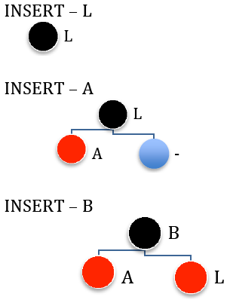
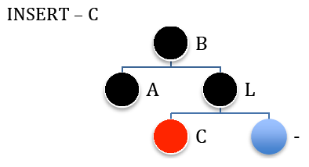
Insertion Example
Inserting string “LABCOMPUTING” (1)

Slide 28
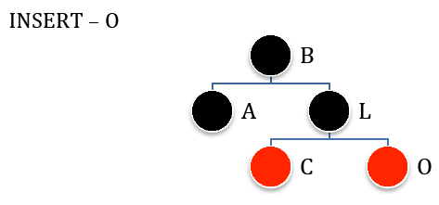
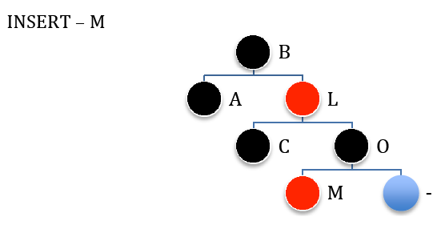
Insertion Example
Inserting string “LABCOMPUTING” (2)

Slide 29
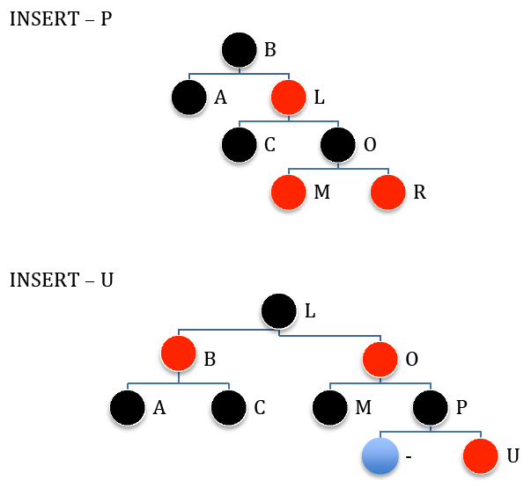
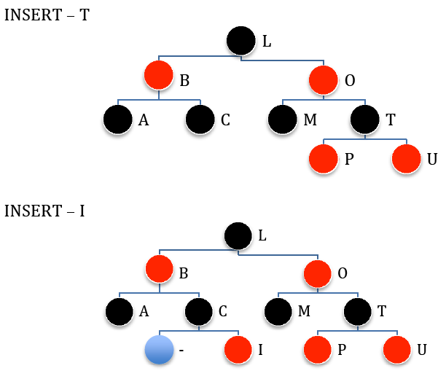
Insertion Example
Inserting string “LABCOMPUTING” (3)

Slide 30
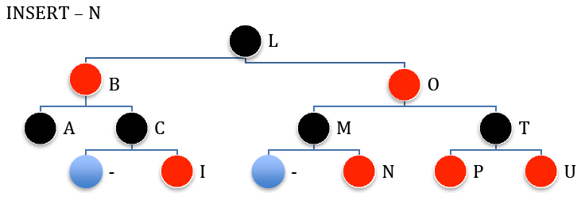
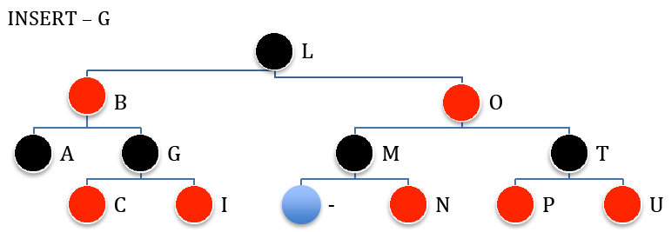
Insertion Example
Inserting string “LABCOMPUTING” (4)

Slide 31
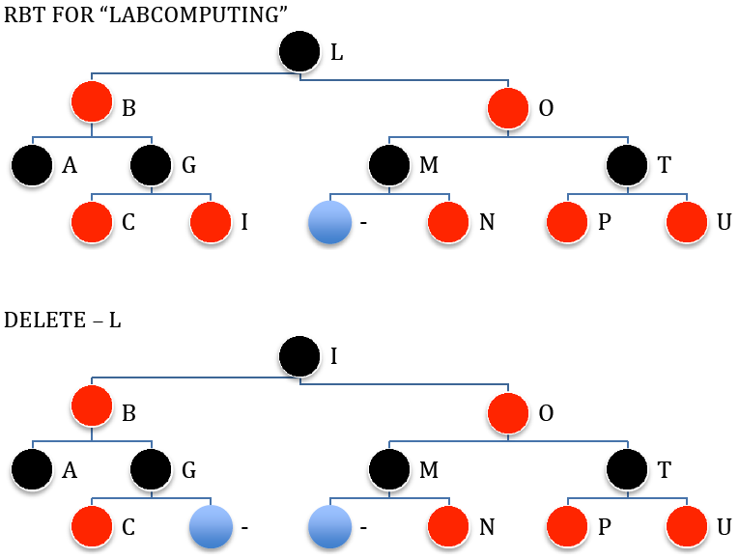
Deletion Example
Deleting string “LABCOMPUTING” (1)
Deleting a node is just like deleting in binary search tree (if it is a node with two children, find the maximum element in its left sub-tree or minimum element in its right sub-tree).
Let the node to be deleted (L) be M, and its child (I) be C.
M is black and C is red, replace it with C and recolor C with black.

Slide 32
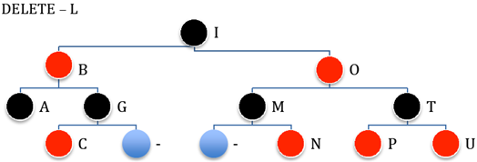
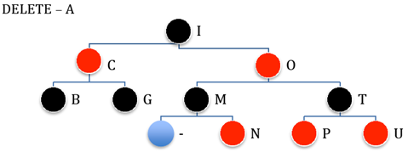
Deletion Example
Deleting string “LABCOMPUTING” (2)
Let the node to be deleted (A) be M, and its child (External Node) be C.
M and C are black, replace M with C.
Let’s denote C in its new position be N (it’s also called a double black), its parent be P, its sibling be S, S_{L} be S’s left child and S_{R} be S’s right child.
S is black and S_{L} or S_{R} is red, then double rotate.

Slide 33
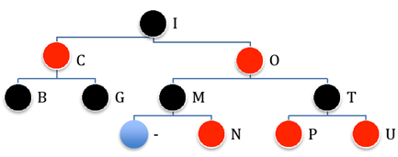
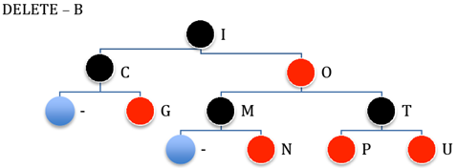
Deletion Example
Deleting string “LABCOMPUTING” (2)
Let the node to be deleted (B) be M, and its child (External Node) be C.
M and C are black, replace M with C.
Let’s denote C in its new position be N (it’s also called a double black), its parent be P, its sibling be S, S_{L} be S’s left child and S_{R} be S’s right child.
S, S_{L} and S_{R} are black, then recolor S as red.

Slide 34
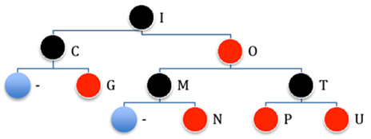
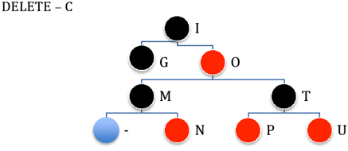
Deletion Example
Deleting string “LABCOMPUTING” (3)
Let the node to be deleted (C) be M, and its child (G) be C.
M is black and C is red, replace it with C and recolor C with black.

Slide 35
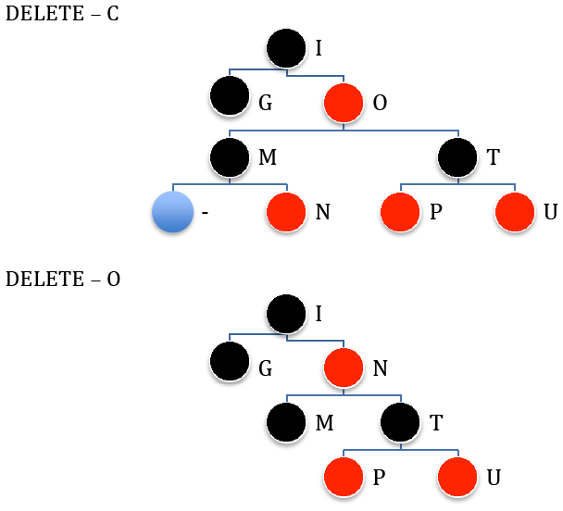
Deletion Example
Deleting string “LABCOMPUTING” (3)
Let the node to be deleted (O) be M, and its child (N) be C.
M is red, then simply replace it with C

Slide 36
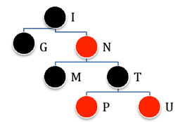
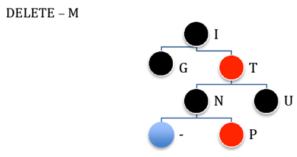
Deletion Example
Deleting string “LABCOMPUTING” (4)
Let the node to be deleted (M) be M, and its child (External Node) be C.
M and C are black, replace M with C.
Let’s denote C in its new position be N (it’s also called a double black), its parent be P, its sibling be S, S_{L} be S’s left child and S_{R} be S’s right child.
S is black and S_{L} or S_{R} is red, then single rotate

Slide 37
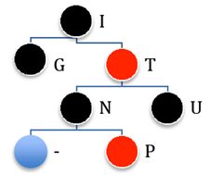
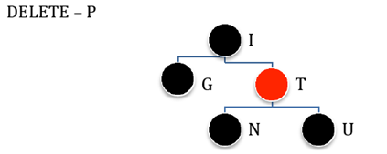
Deletion Example
Deleting string “LABCOMPUTING” (4)
Let the node to be deleted (P) be M, and its child (External Node) be C.
M is a Leaf and no Sibling, then simply delete M

Slide 38
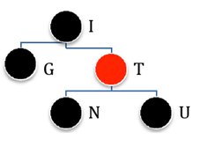
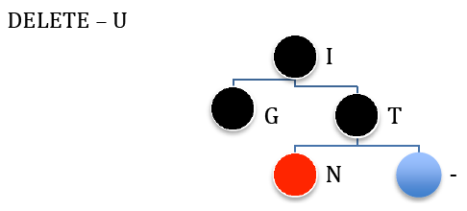
Deletion Example
Deleting string “LABCOMPUTING” (4)
Let the node to be deleted (U) be M, and its child (External Node) be C.
M (it’s also called a double black), its parent be P, its sibling be S, S_{L} be S’s left child and S_{R} be S’s right child.
S, S_{L} and S_{R} are black, then recolor S as red.
Double black change place to P, because P (T) is red, simply recolor it to black.

Slide 39
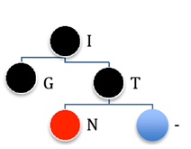
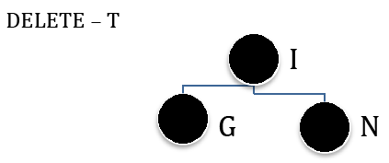
Deletion Example
Deleting string “LABCOMPUTING” (4)
Let the node to be deleted (T) be M, and its child (N) be C.
M is black and C is red, replace it with C and recolor C with black.

Slide 40
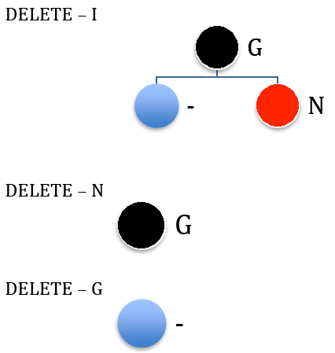
Deletion Example
Deleting string “LABCOMPUTING” (5)
Let the node to be deleted (N) be M, and its child (External Node) be C.
M is black and C is red, replace it with C and recolor C with black.

Slide 41
References
Reema Thareja. 2014. Data structures using C. Oxford University Press. New Delhi. ISBN:9780198099307. Chapter 10
Thomas H. Cormen, Charles E. Leiserson, Ronald L. Rivest, & Clifford Stein. (2009). Introduction to Algorithms. 03. The MIT Press. London. ISBN: 9780262033848. Chapter 13
Red Black Tree, http://www.cs.usfca.edu/~galles/visualization/RedBlack.html

